Slide 1
Looking Ahead: Understanding & Navigating Upcoming Practice Changes
June 2024
Notes:
**NOTE TO PRESENTER**
These notes supplement each slide with prompts and talking points to provide guidance to you, the presenter, as you review key points and highlight additional resources with the audience. Prompts are marked with asterisks (**) and talking points are listed in bullet form.
THROUGHOUT THE PRESENTATION, POINT TO FACTS.REALTOR AS THE AUTHORITATIVE SOURCE OF INFORMATION ON THE SETTLEMENT.

Slide 2
WHAT’S INSIDE?
As the real estate industry adapts to coming changes following NAR’s recent settlement agreement, we want to prepare you for a smooth transition and arm you with the tools you need to speak to consumers about the new landscape. In this presentation we cover:
A settlement overview, reviewing what the changes are and implementation details.
Understanding the impact, including important considerations as the industry adapts.
Talking to consumers about the coming changes, giving you a guide on how to help them understand what the practice changes mean for them and their residential transactions.
Notes:
This presentation is an educational resource on the settlement and its impact, and provides guidance on how to explain the coming changes to consumers.
With so much information in the market about how the settlement may affect how real estate professionals do business and the public buys and sells homes, it is important that we understand the changes following the settlement to help consumers navigate the path forward.

Slide 3
SETTLEMENT OVERVIEW
Notes:
Before we dive into practical advice on communicating with consumers, we will first review the settlement, its key terms, and how it will change the real estate industry.

Slide 4
BACKGROUND
On March 15, 2024, NAR announced a proposed settlement agreement that would end litigation of claims against NAR, all state/territorial and local associations, most MLSs, almost all members, and most of their brokerages, brought on behalf of home sellers related to broker commissions.
The court granted preliminary approval on April 24, 2024. But the settlement is subject to final court approval. A hearing on final approval is scheduled for November 26, 2024.
From the beginning of this litigation, NAR had three goals:
  Secure a release of liability for as many members, associations, and MLSs as possible;
  Protect the choices consumers have regarding real estate services and compensation; and
  Continue to promote the American dream of home ownership
Notes:
**Walk through bullets precisely on this slide to ensure language is clear**
Facts.realtor is the place for the latest information on the settlement and includes a detailed FAQ for REALTORS®, a timeline of key milestones, and other resources to support the NAR membership and consumers as we adapt to the new landscape.

Slide 5
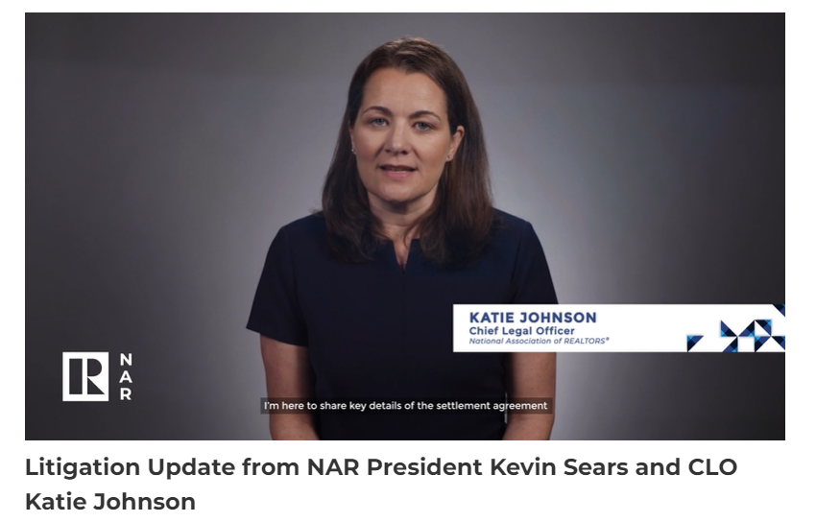
VIDEO SNAPSHOT: SETTLEMENT EXPLAINED
▶️
Notes:
**Show video**
LINK: https://www.nar.realtor/videos/litigation-update-from-nar-president-kevin-sears-and-clo-katie-johnson
This video breaks down the settlement terms, who is covered, practice changes and what this all means for REALTORS®.
For additional information on the settlement, visit facts.realtor where there is a FAQ that explains all nuances of the settlement.

Slide 6
CORE ASPECTS OF THE SETTLEMENT
1
Release of liability
2
Offers of Compensation prohibited on MLS
3
Written buyer agreements required
4
NAR continues to deny any wrongdoing
Notes:
**The following is covered in the video, but we suggest giving a quick recap of the key takeaways**
Practice changes you just heard about will go into effect on August 17, 2024. To review the main points:
Release of liability: The agreement resolves claims against NAR members, all state/territorial and local REALTOR® associations, all association-owned Multiple Listing Services (MLSs) and brokerages with an NAR member as principal that had a residential transaction volume in 2022 of $2 billion or below. The agreement provides a mechanism for nearly all brokerage entities that had a residential transaction volume in 2022 that exceeded $2 billion to obtain releases efficiently if they choose to use it.
Compensation offers moved off the MLS: Offers of compensation will be prohibited on the MLS, but will continue to be an option consumers can pursue off-MLS through negotiation and consultation with real estate professionals.
Written agreements for MLS Participants acting for buyers: Agents working with buyers must enter into signed written agreements with their buyers before touring a home outlining how much the buyer has agreed to pay for brokerage services and how it will be paid.
NAR did not admit any wrongdoing throughout the settlement process.

Slide 7
NAR SETTLEMENT TIMELINE*
*As of June 24, 2024. Please refer to the settlement agreement for detailed information on deadlines.
**NAR encourages all MLSs to implement the practice changes by August 17, 2024.
MAR
APR
MAY
JUNE
JULY
AUG
SEPT
OCT
NOV
DEC
JUNE 18
Deadline for REALTOR® MLSs to execute Appendix B (to be included as a Released Party)
Deadline for brokerages to execute Appendix C (to be included as a Released Party)
Deadline for non-REALTOR® MLSs to execute Appendix D (to be included as a Released Party)
MAR 22
NAR filed Notice of Settlement / withdrew pending motions and sought to stay litigation
APR 23
Preliminary Approval granted
~SEP
Anticipated Motion in Support of Final Approval
NOV 26
Hearing for Final Approval
MAR 15
Settlement agreement signed
APR 19
Plaintiffs filed Motion for Preliminary Approval
AUG 17
Earliest date for Plaintiffs to issue class notice
New NAR MLS Policy takes effect to implement practice changes
Deadline for REALTOR® MLSs to implement policy changes pursuant to mandatory NAR policy**
SEP 16
Deadline for REALTOR® MLSs and opting-in non-REALTOR® MLSs to implement practice changes to be a Released Party under the settlement agreement
Notes:
I wanted to draw your attention to a few key dates:
The next key milestone in this timeline is August 17, when the practice changes outlined in the settlement will take effect. Later in this presentation, we’ll discuss the impact of these practice changes on consumers.
The final approval hearing is scheduled on November 26, which is when the settlement could be approved by the court and formally go into effect.

Slide 8
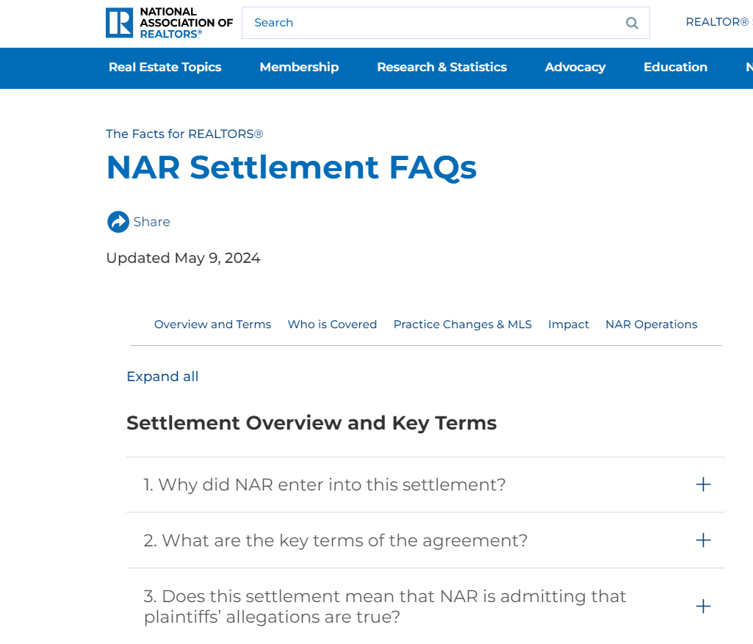
SETTLEMENT RESOURCES
Settlement-related resources for NAR members are available at facts.realtor.
Available resources include:
  Full settlement agreement language
  Settlement overview
  Settlement FAQs
  Summary of MLS Policy Changes
  Explainer videos
  Timeline for key milestones
  Written buyer agreement 101 guide
  Opt-in agreement forms and instructions
Notes:
Facts.realtor is your number one source of information about the settlement. I would recommend bookmarking it and encouraging members you speak with to bookmark it as well.
These are just some of the resources included on the website, but in particular I would draw folks’ attention to:
The overview and FAQs
The timeline
The guides to specific practice changes like MLS policies and written buyer agreements
Resources are added and information is updated regularly, so check back for updates and make sure you are receiving NAR newsletters to be alerted when those new resources are available.

Slide 9
UNDERSTANDING THE IMPACT
Notes:
In this section, we’ll get into the impact the settlement will have on REALTORS® and consumers.

Slide 10
CONSUMER CHOICE
The settlement preserves consumer choice in the home buying and selling process:
Cooperative compensation, or the ability of listing agents to compensate agents representing buyers, is prohibited on-MLS, but preserved as an option off-MLS based on negotiation between consumers and real estate professionals.
Buyers and sellers will continue to have the flexibility to negotiate the commissions and fees that work for them and their transaction.
Written buyer agreements will clearly outline the services buyers will receive, and how much they will cost.
Notes:
One of the most important aspects of the settlement is that it preserves the ability of listing agents to compensate buyers’ agents.
Cooperative compensation benefits both buyers and sellers.
For buyers, it promotes access to representation throughout the home buying process, which helps more people achieve the dream of homeownership on terms that work best for them.
For sellers, cooperative compensation helps to broaden the pool of prospective buyers by lowering the barrier to entry for those that may not be able to afford to pay a commission out of pocket—particularly for lower- and middle-income buyers who can have challenges saving for a down payment.
Just as it was before the settlement, commissions and fees will remain fully negotiable.
Written buyer agreements will also help to promote transparency between buyers’ agents and their clients.

Slide 11
PRESERVING ACCESS TO HOMEOWNERSHIP
A key priority of the settlement is to ensure that offers of compensation remain an option off-MLS because they are a critical tool to ensure the American Dream of homeownership remains accessible to all, including first-time buyers, low-income buyers, and Veterans.
Fannie Mae and Freddie Mac have both confirmed that buyers whose agents are compensated by the seller will continue to have access to financing under the agencies.
The Department of Veterans Affairs recently announced that it has temporarily lifted its ban on buyers paying for real estate agent representation. Veteran buyers now have more options, ensuring they can have professional access to representation in their home buying process. The VA’s policy takes effect on August 10.
Notes:
As REALTORS®, we are in the business of helping our clients achieve the American Dream, and the settlement aims to ensure this remains accessible to everyone, including groups who rely on pillars of the housing finance system like Fannie Mae, Freddie Mac, and VA loans
NAR has advocated especially strongly for the VA to lift its ban on offers of compensation for buyers using VA loans, and recently the VA announced that the ban was temporarily lifted pending further rulemaking. We will continue to update you as this process gets underway.
LINK to NAR announcement on VA update: https://www.nar.realtor/magazine/real-estate-news/veterans-affairs-removes-compensation-hurdle-for-military-buyers
LINK to VA press release: https://news.va.gov/press-room/va-announces-updates-to-help-veterans-using-va-home-loan-benefits-remain-competitive-in-the-housing-market/

Slide 12
NAR SUPPORTS FAIR HOUSING
Offers of compensation are just one part of ensuring fair housing
REALTORS® also must ensure that while we are negotiating with each consumer, we are not treating them differently because of their race, sex, national origin, or other protected characteristic. The settlement does not change this.
When it comes to the key components of the settlement:
  As REALTORS® present buyer agreements, we must ensure that we are opening the conversation in the same way with every buyer.
  As before the settlement, it is the seller’s decision whether to authorize offers of compensation to buyer brokers, but it is illegal to refuse to authorize compensation, or to offer different compensation, because of the buyer, or the buyer’s agent’s national origin, gender, race, or other protected characteristic.
REALTORS® have an obligation to follow the Code of Ethics and the law.
Notes:
Just as before the settlement, REALTORS® are obligated legally and ethically to uphold fair housing principles and to ensure all people, including other REALTORS® are treated equally throughout a home buying or selling process.
This means opening the conversation in the same way with every buyer when presenting buyer agreements, or ensuring that there is no differential treatment when discussing offers of compensation.
It is also important to note that there is a great deal of concern about how the settlement will impact buyers who have historically been disadvantaged in the housing market.
We all need to listen actively to these concerns, and NAR is working toward policy solutions that will support these communities after the practice changes are fully implemented in August.
As it always is, it is important to communicate transparently with buyers and sellers in these communities to make them aware of the options available to them and reassure them they still have choice throughout the process.
As you describe your value as a REALTOR®, emphasize the Code of Ethics as a differentiator, as only REALTORS® are bound by these ethics in addition to following all fair housing laws like all other market participants.

Slide 13
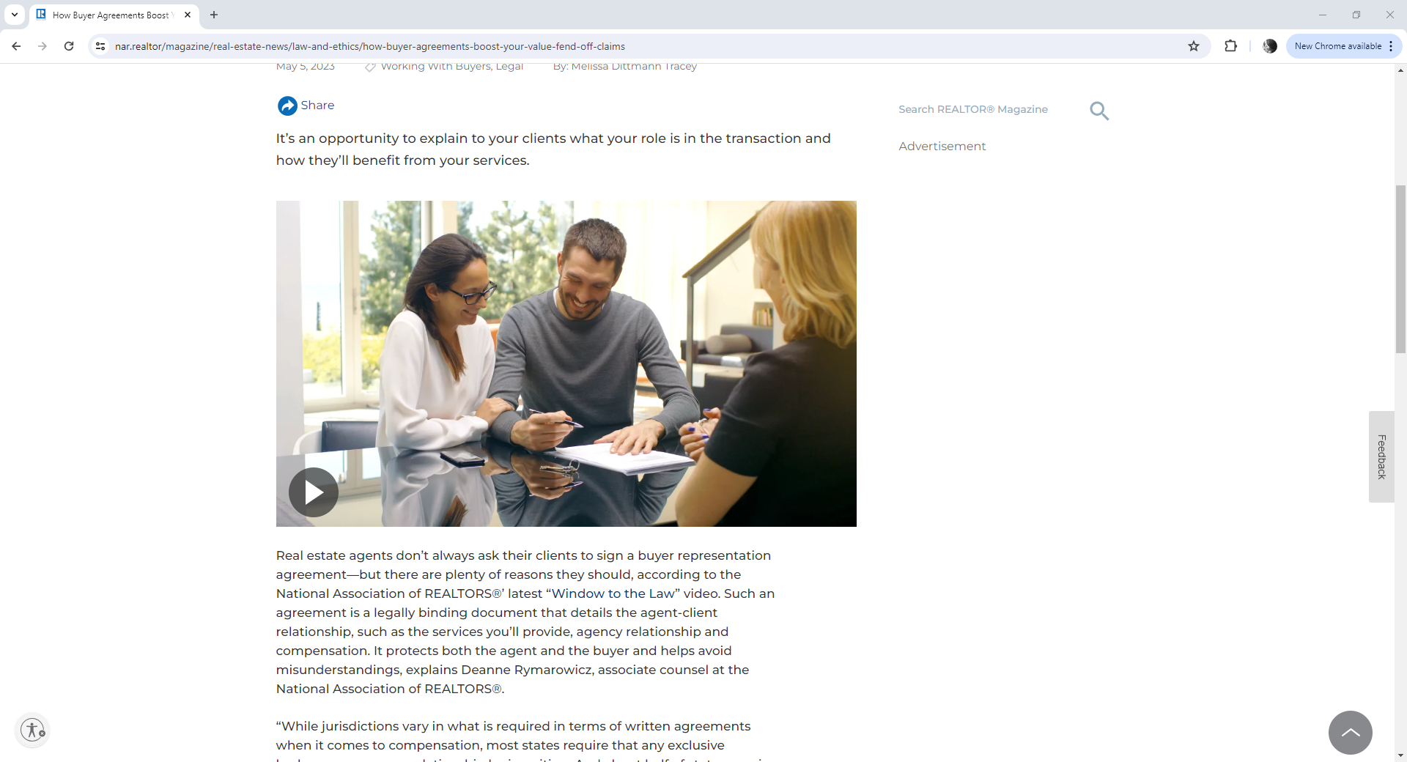
BUYER AGREEMENTS
NAR has long encouraged use of Buyer Agreements because they clearly outline the services to be provided and account for choice and optionality the buyer and agent have when negotiating the terms of their relationship.
Video Snapshot: Buyer Agreements Highlight Value
Notes:
Buyer agreements facilitate a transparent and clear relationship between an agent and a consumer, and NAR has long encouraged their use.
We have another video here that speaks more about buyer agreements.
**Show video**

Slide 14
TALKING TO CONSUMERS ABOUT COMING CHANGES
Notes:
Now that we’ve gone through the key components of the settlement and its impacts, let’s walk through how we can talk to consumers about the changes.
The settlement is obviously legal in nature, and it’s important to communicate the changes in plain, clear language that everyone will understand.

Slide 15
REALTORS® play a pivotal role in guiding and supporting home buyers and sellers as we adapt to the changing landscape.
The following slides are intended to serve as a guide for conversations with consumers.
Notes:
Consumers look to REALTORS® to guide them in what, for many of them, is the biggest financial transaction they will ever make.
In the following slides, we’ve outlined an approach to these conversations in addition to important talking points you can keep in mind when speaking with consumers.

Slide 16
ALWAYS COMMUNICATE YOUR VALUE
We know the value agents who are REALTORS® bring to real estate transactions, and need to continue clearly articulating that value to consumers.
When talking to consumers, focus on what matters to them most, such as:
Reducing stress in a highly complicated and high stakes transaction, likely one of the biggest of their lives.
Serving as a trusted advisor through the transaction and demystifying the home buying or selling process.
Using your extensive experience to navigate difficult negotiations, write the best offer possible, set the right price for a listing, and help consumers avoid common mistakes—all to ultimately help successfully close a transaction, saving consumers money and time.
Notes:
When in doubt, lean on the fundamental value that REALTORS® provide consumers.
Even with the settlement, consumers look to their agents to guide them through a challenging and intense process.

Slide 17
EXPLAIN WHAT TO EXPECT IN PLAIN LANGUAGE
Offers of Compensation
First and foremost, a REALTOR®’s duty under the REALTOR® Code of Ethics has been and continues to be to have open and honest conversations with consumers throughout the home buying or selling process.
As before the settlement, REALTORS® must explain compensation is fully negotiable, and offers of compensation remain an option as a matter of negotiation between the real estate professional and the consumer.
When listing brokers make offers of compensation, under the settlement there are changes to where they may communicate those offers.
Offers of compensation are no longer allowed on Multiple Listing Services (MLSs)—local marketplaces used by both buyer brokers and listing brokers to share information about home inventory.
However, listing brokers can still make offers of compensation off-MLS, and sellers can still offer buyer concessions on an MLS (for example, concessions for buyer closing costs).
Notes:
Use consumer-friendly language to discuss the changes to MLS policies, including what an MLS is, and what it means for commission payments by sellers’ and buyers’ agents—as many home buyers and sellers may be completely unfamiliar with these industry practices.

Slide 18
EXPLAIN WHAT TO EXPECT IN PLAIN LANGUAGE
Written Buyer Agreements
You will need to sign a written agreement with your agent before touring a home so you understand exactly what services and value will be provided, and for how much.
Written agreements are required for both in-person and live virtual home tours.
You do not need a written agreement if you are just speaking to an agent at an open house or asking them about their services.
Agent compensation for home buyers continues to be fully negotiable.
When finding an agent to work with, ask questions about compensation and these written agreements.
Several states already have laws requiring buyer agreements – check your state laws on buyer agreements as you search for an agent.
Note: MLS Participants and buyers are not required to enter into any particular relationship, and will still be able to enter into any type of professional relationship permitted by state law.
Notes:
Again, it is important to use consumer-friendly language to discuss written buyer agreements.
Emphasize that these agreements are negotiable and provide optionality for consumers.
Agreements will be crafted to best meet the needs of the consumer including how long it lasts, what level of services will be provided, and a how an agent will be compensated.
Make sure consumers understand the requirement for an agreement before any in-person or virtual tour.

Slide 19
Please direct consumers to facts.realtor for more information.
Notes:
Facts.realtor is the home of all the latest information on the settlement for consumers and members alike

Slide 20
A note to our members
NAR is here to support you through this transition.
The Accredited Buyer’s Representative course (or ABR course) is available to members at no cost in 2024. This program is typically valued at $295. Learn more at become.abr.realtor.
Notes:
This is just a closing note to emphasize that NAR is here to help in this transitional time for our members.
Especially with the changes to buyer agreements, we are offering the Accredited Buyer’s Representative course at no cost in 2024.
We hope this presentation was helpful as you continue to have important conversations about the settlement and the changes coming along with it.

